Slide 1





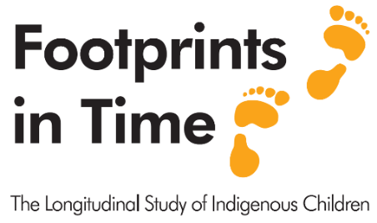
Recent findings from
Footprints in Time: the longitudinal study of Indigenous children (LSIC)
Christine Urbanowski and Fiona Skelton
Social determinants of education

Slide 2

      We acknowledge the Traditional Custodians of the land on which we meet today and their connections to land, water, culture and community.
      We pay our respects to the Elders past and present and extend that respect to all Aboriginal and
      Torres Strait Islander peoples
Aboriginal and Torres Strait Islander people should be aware that this presentation includes
images of people who may have passed away.
Notes:
Source Melbourne Night Shot Station - Free photo on Pixabay - Pixabay

Slide 3
Roadmap of this presentation
  Overview of Footprints in Time: the longitudinal study of Indigenous children (LSIC)
  Findings from recent and forthcoming publications
    LSIC Primary School Report (2024)
    LSIC Wave 11 – 12 Report
    LSIC Wave 13 Report

Slide 4
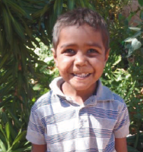
Footprints in Time: the longitudinal study of Indigenous children (LSIC)
The overview
Notes:
My name is Christine Urbanowski and I have been interviewing families in this study every year since 2008
I get to see the children grow, many of them are taller than me now, and to ask them how they are going and what are they doing and to celebrate their achievements

Slide 5
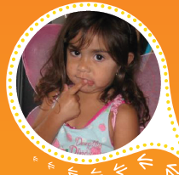

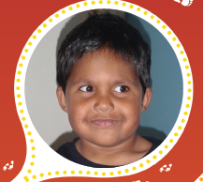
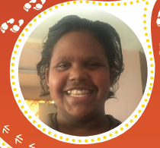
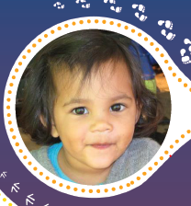
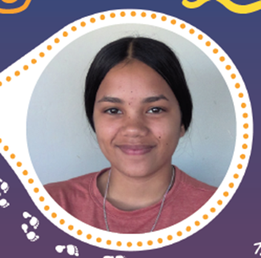

LSIC at a glance
Two cohorts of Aboriginal and / or Torres Strait Islander children:
  Younger (B) cohort – born 2006-2008 ~700-950 children
  Older (K) cohort – born 2003-2005 ~500-700 children
Mix of urban, regional and remote locations.
Not representative of all Indigenous children in Australia.
Annual data collection started in 2008 (Wave 1):
  Primary parent and child survey (face-to-face)
  Dad/parent 2 and educator surveys
  (self-complete on paper or online)
Currently Wave 17 in the field.
13 waves of data currently available to approved data users.

Slide 6
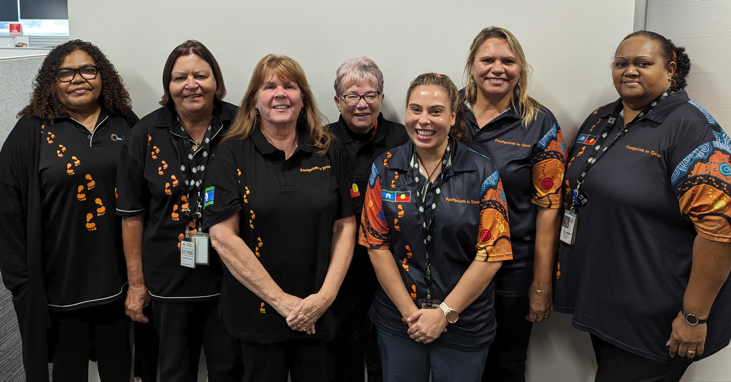
Who is involved?
Funded by the Australian Government
Guided by a majority Indigenous Steering Committee chaired by Associate Professor Kalinda Griffiths
Managed by the Longitudinal Studies teams in Department of Social Services (DSS)
Interviewers are Indigenous DSS staff members people, usually from the area where they do interviews.
Roy Morgan Research contracted to capture and compile survey data from W13.
LSIC Research Administration Officers
(RAOs – interviewers)
Notes:
Associate Professor Kalinda Griffiths is a Yawuru woman of Broome, is the Director Poche SA+NT - Flinders University, is an early career Scientia Lecturer at the Centre for Big Data Research at UNSW, holds an honorary position at Menzies School of Health Research and is a visiting Fellow at the University of NSW. She is also Aboriginal and Torres Strait Islander Research and Education Lead at the Victorian Comprehensive Cancer Centre Alliance. Associate Professor Griffiths is an epidemiologist who has worked in the research sector in a number of roles for over 25 years.

Slide 7
Number of participants interviewed
Study Youth (SY), Primary Carer (P1) and Other Carer (P2) since Wave 11
(*SY original cohort = 1759)

Slide 8
Geographical location of Study Youth (%)
Notes:
We were not able to interview face to face in Wave 13 – the COVID year and since then we have done some interviews by phone and online self complete but we still get the best response by going out to families

Slide 9
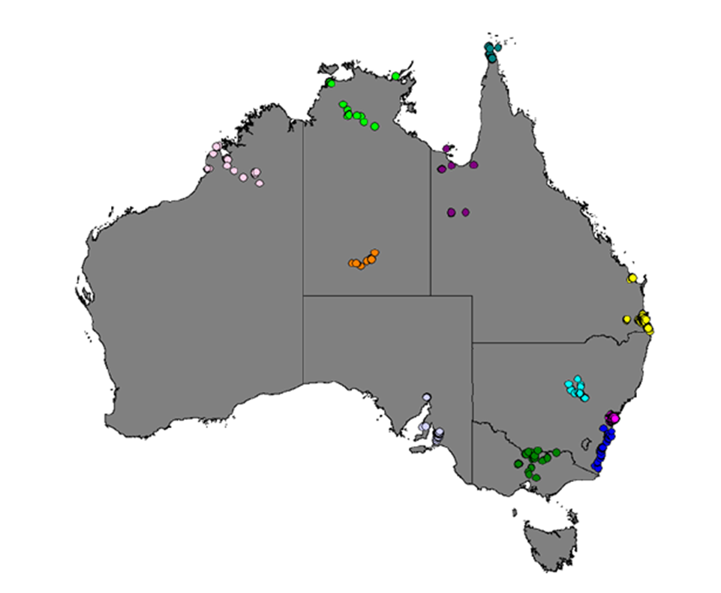
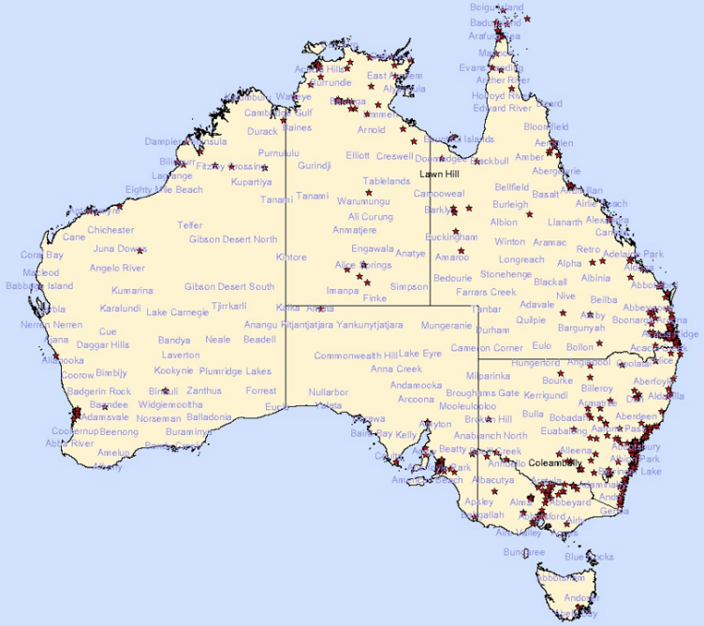
Where do LSIC families live?
LSIC Participants Wave 1 (2008)
LSIC Participant locations Wave 16 (2023)

Slide 10
LSIC Data User Snapshot
How many people are using the LSIC Data:
  459 data users of LSIC (W9 – W13)
  71% academic
  16% Australian government
  3% state government
Top topics: Health & wellbeing, education, government, policy, disadvantage, adversity & resilience

Slide 11
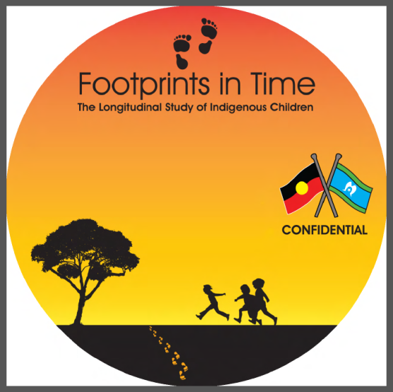
Getting the LSIC data
Cultural, security and confidentiality protocols apply
Application is through the Australian Data Archive.
Forms and applications can be found at:
www.dataverse.ada.edu.au/dataverse/DSSLongitudinalStudies
Questions about getting the data:
longitudinalsurveys@dss.gov.au
Questions about using the data:
LSICdata@dss.gov.au
Notes:
When you apply for the data you need to give your “cultural standpoint” - as Requested by the Steering Committee

Slide 12
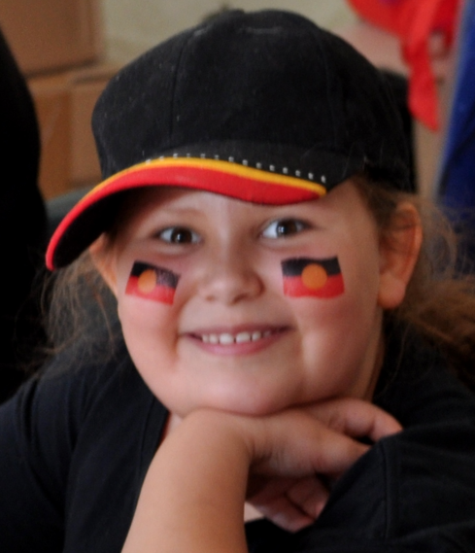
LSIC Primary School Report
(published in April 2024)

Slide 13
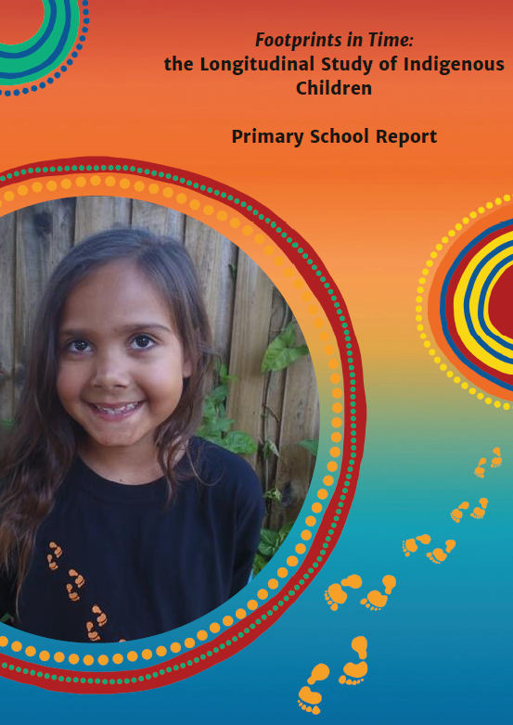
Footprints in Time: The Longitudinal Study of Indigenous Children – Primary School Report
Written by researchers from the Queensland University of Technology: Dr Jessa Rogers and Professor Kate Williams are the lead authors
Uses a mixed-methods approach, analysing both quantitative and qualitative data shared by the Footprints in Time participants
Also available as a summary and in factsheets designed for:
- Education Bodies and Professionals
  - Peak Bodies and Key Stakeholders
  - Participating Teachers and Schools
  - Participating Youth, Family and Community

Slide 14
Some of the findings from the report
What helped students develop stronger literacy and numeracy?
Teachers who made learning enjoyable, and understood and listened to their students
Fewer experiences of interpersonal conflict between student and teacher
Stronger student overall wellbeing in relationships, emotions, and behaviour
Student enjoyment of school, persistence in the classroom,
organisational skills, and independence

Slide 15
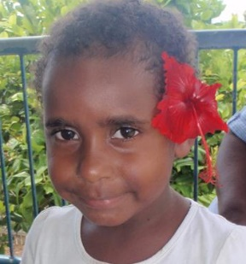
Which experiences supported stronger engagement with school?
A positive school climate
Lower levels of student-teacher conflict
Strong early skills in managing emotions and attention
Stronger social skills
Fewer problems in engagement with peers
Higher confidence and enjoyment of reading
Greater parent involvement in school activities

Slide 16
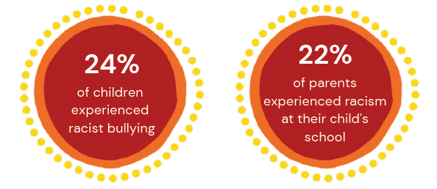
Racism in School
Students experienced racist bullying at school across all geographic regions, but this was most likely to occur in major cities.
When parents said their child had not experienced racism at school, their child had stronger social-emotional wellbeing, managed better at school, and achieved better academically.

Slide 17
How teachers may inadvertently perpetuate discrimination in schools:
When asked how they deal with racism, discrimination, or prejudice, a proportion of teachers' responses indicated that they may perpetuate racial inequalities and inequities by not recognising cultural differences and identities.
Colour blindness:
“I aim to treat each child the same as any other in terms of race. I also aim to teach this to my students. I emphasise that a colour or religion is not what makes us different. We are each unique and we should appreciate this.”
Lack of recognition of racism:
"Being a culturally diverse school, these issues are not
really present"

Slide 18
Aboriginal and Torres Strait Islander Education Initiatives
Many schools celebrated Indigenous days of significance (78%) and had teachers who knew their Indigenous students (76%).
Fewer schools taught about Indigenous culture (47%) or had Elders visit or teach (35%).
Schools who regularly engaged in Aboriginal and Torres Strait Islander education initiatives were more likely to be in regional or remote areas where there were higher proportions of Indigenous students.

Slide 19
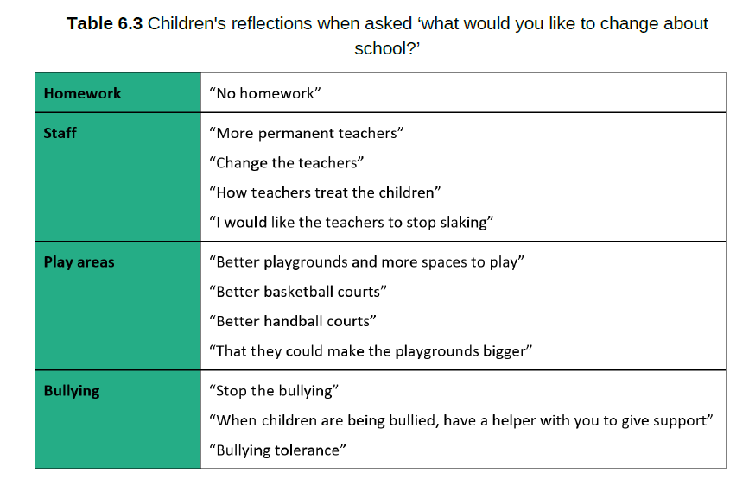
What would children change about school?

Slide 20

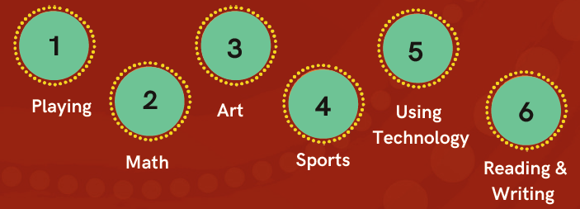
and many more findings…
Children’s favourite things to do at school were (in order):

Slide 21
Some of the recommendations from the report
  Boost pre-service and in-service teacher cultural training – potential for far-reaching impacts (reducing racism, parent and child engagement, achievement, wellbeing)
  Positive teacher-student relationships are a must, reducing conflict is critical
  Consider more consistent national homework policy for primary school based in evidence of impacts vs benefits for children and families
  Engage school community in policies to address racist bullying:
    Teachers rely heavily on these so they must be robust and clear.

Slide 22
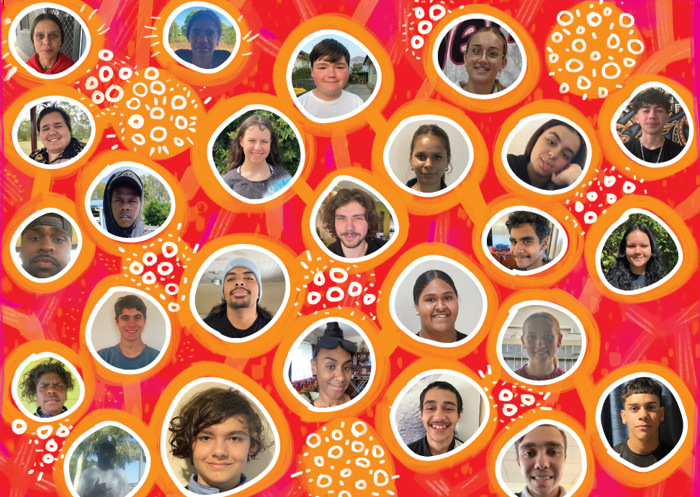
LSIC Wave 11 – 12 Report
LSIC Wave 13 Report
(forthcoming)

Slide 23
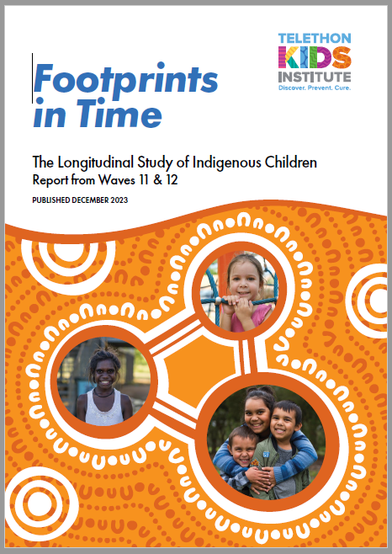
Footprints in Time: The Longitudinal Study of Indigenous Children –
Wave 11 – 12 (2018-19) Report
Written by researchers in the Telethon Kids Institute
Primarily uses Wave 11 and 12 data collected in 2018 and 2019
LSIC Youth 10 – 16 years old
Comes with five Factsheets with different themes
  Cultural pride in adolescence
  Family relationships and wellbeing
  Wellbeing and experiences of racism
  Youth online: safe and connected
  Relationships during early adolescence

Slide 24
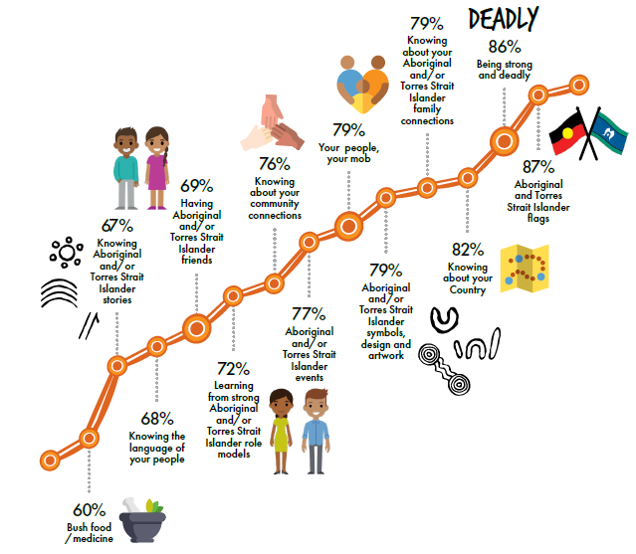

Cultural aspects LSIC youth said
were important or very important to them (Wave 11-12 Report)

Slide 25

Online safety (Wave 11-12 Report)
Parents and caregivers reported higher levels of LSIC Youth’s wellbeing when…
LSIC Youth used the internet at school
LSIC Youth had rules at home about how much time they use the internet
Parents and caregivers said they felt their child was safe on the internet
Parents and caregivers felt confident they knew about being safe on the internet
Notes:
From W11-12 Report Safety Online Factsheet:
‘For children and young people, wellbeing means that they are safe, comfortable, happy and feeling good about themselves. They are ready to learn and to grow up strong.’

Slide 26
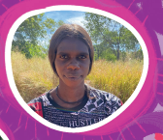
Footprints in Time: The Longitudinal Study of Indigenous Children –
Wave 13 (2020) Report
Written by researchers in the Australian National University
Primarily uses Wave 13 data collected in 2020 (only phone interviews due to pandemic restrictions)
LSIC Youth 12 – 17 years old
Comes with five Factsheets with different themes
  Growing up strong
  Impact of COVID-19
  Work participation and aspirations
  Education participation
  Financial stress and wellbeing

Slide 27
The socioeconomic impacts of COVID-19 on LSIC youth and their families
COVID-19 had minimal direct health effects (in terms of infection and death) on
Footprints in Time families in 2020.
Many parents and carers, enjoyed increased family time and experienced overall improvements in employment, income and finance compared with pre-pandemic levels.
For LSIC Youth, COVID-19 had both positive and negative impacts on education.
  For some (37%), remote learning led to less distraction from peers, increased focus on learning activities and less exposure to bullying behaviours.
  For others (36%), COVID-19 increased isolation from peers and social networks and limited access to learning resources.
COVID-19 disrupted communities’ access to food and other essential items, especially in regional (57%) and remote areas (58%).

Slide 28
What ‘grow up strong’ means for LSIC Youth (Wave 13 Report)
Being positive
Strong person
Healthy
Resilience
Being brave
Family
Doing the right thing
Being proud
Doing best
Culture strong
Good education
Enjoy life
Being independent
Being respectful
Perseverance
Emotionally strong
Confidence
Strong character (role model)
Being smart
Good job
Strong physically & mentally
Happy and safe
Achieving goals
Community
Being focused

Slide 29
What ‘grow up strong’ means for LSIC Youth (continued)
“Growing up confident in yourself and not letting anyone pushing you down and following your dreams and being happy in yourself.”
“Looking after and able to provide for myself and my family. Good education so I can get a good job. Be healthy, respect and confident.”
“Proud of your culture, believing in yourself.”
“Don't listen to people when they tell you that you are not good enough, prove them wrong.”
“That whenever something bad happens I will be able to figure it out and make it better and be there for people.”

Slide 30
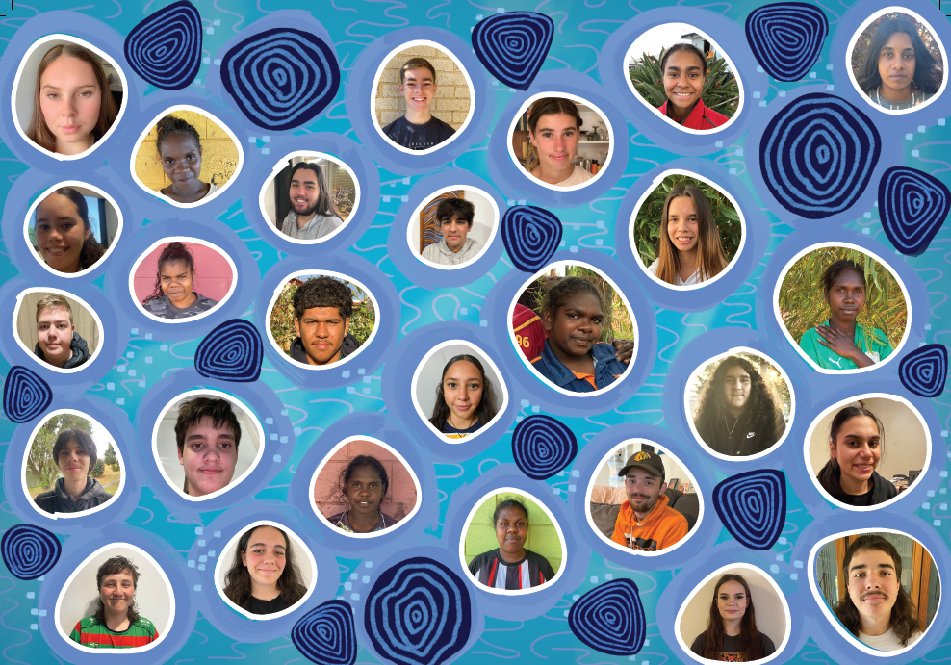
ANY QUESTONS?

Slide 31



More information
Footprints in Time home page
dss.gov.au/lsic
Publications
flosse.dss.gov.au
Contact
LongitudinalStudies@dss.gov.au
Notes:
You can search Flosse for articles related to ‘education’ or by author and so on.

Slide 32

Diverse Destinies - All diverse people, from across our diverse land, each walking their own path and discovering all that life has to offer. Stepping up and taking control of their own destinies. The future is bright.
The artwork represents the journey of Footprints in Time. The circles and dots represent participants, and
the line-work shows the non-linear nature of growth, change and how we are all connected.
Artist -Timothy Buckley - Tim is a proud, queer, Mununjali and South Sea Islander artist and designer. He is inspired by his heritage, history and the diversity of the natural work which gives us all life.

