Slide 1
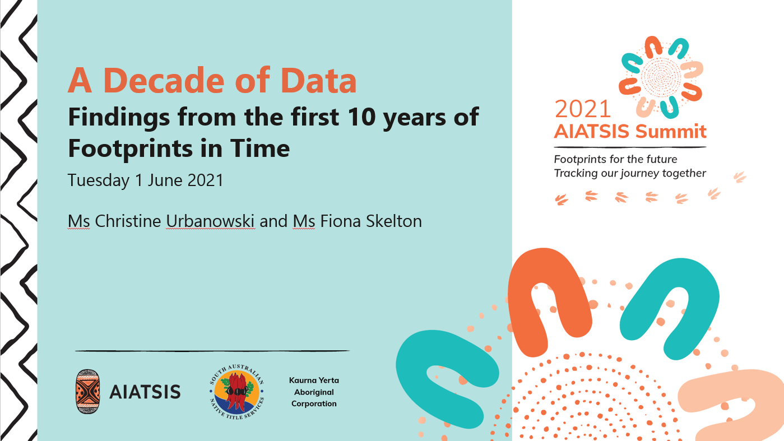
A Decade of Data
Findings from the first 10 years of Footprints in Time
Tuesday 1 June 2021
Ms Fiona Skelton and Ms Christine Urbanowski

Slide 2

      We acknowledge the traditional owners
      on whose land we meet today.
      The Kaurna People.
      We pay our respects to elders
      past present and future
      We extend our respects to all the lands you and the Footprints in Time participants are from

Slide 3
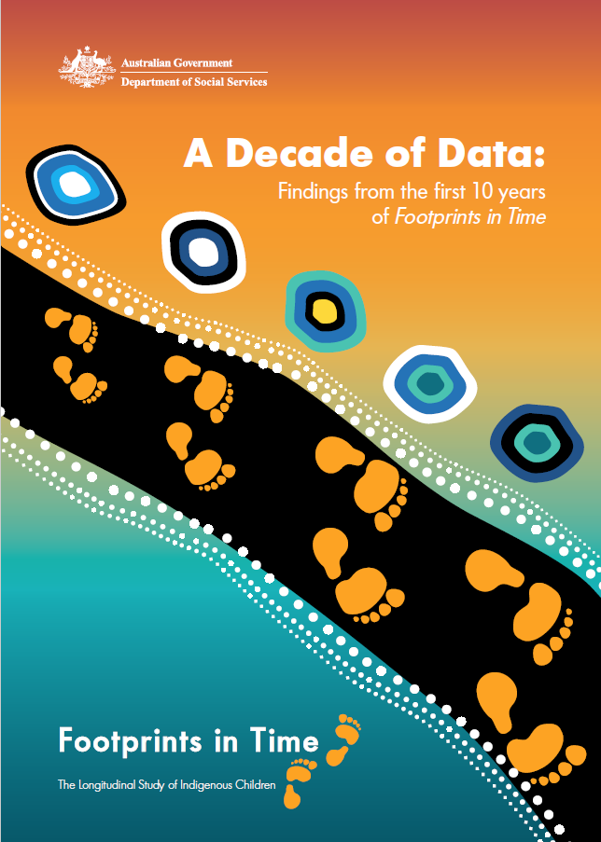
2008 and up:
More than A Decade of Data
Today’s presentation will provide a brief overview of
Footprints in Time: the Longitudinal Study of Indigenous Children (LSIC)
Who governs the study?
What’s it about?
Who is in the study?
What are some findings?
Who uses the data?
Where can I get a copy of A Decade of Data?
Aboriginal and Torres Strait Islander people should be aware that this presentation includes images of people
who may have passed away

Slide 4
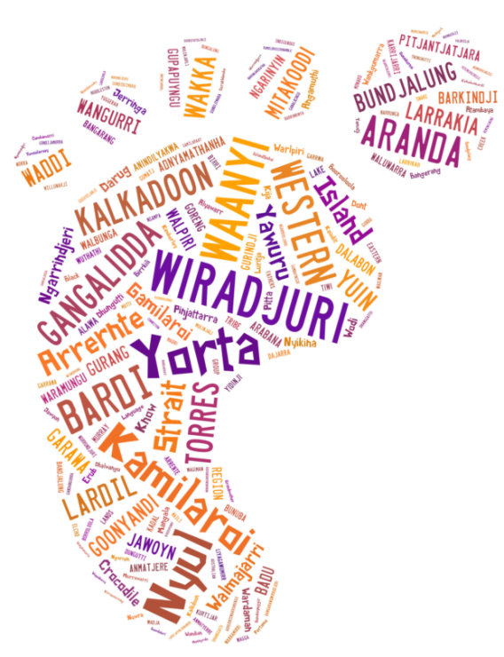
Governance of the Study
The LSIC study design is guided by a Steering Committee with a majority of Indigenous members
Advice is also sought through content design groups with primarily Aboriginal leadership, community elders and participants
Ethical clearance sought through the AIATSIS Ethics committee and jurisdictional committees
Managed by the National Centre for Longitudinal Data in DSS

Slide 5
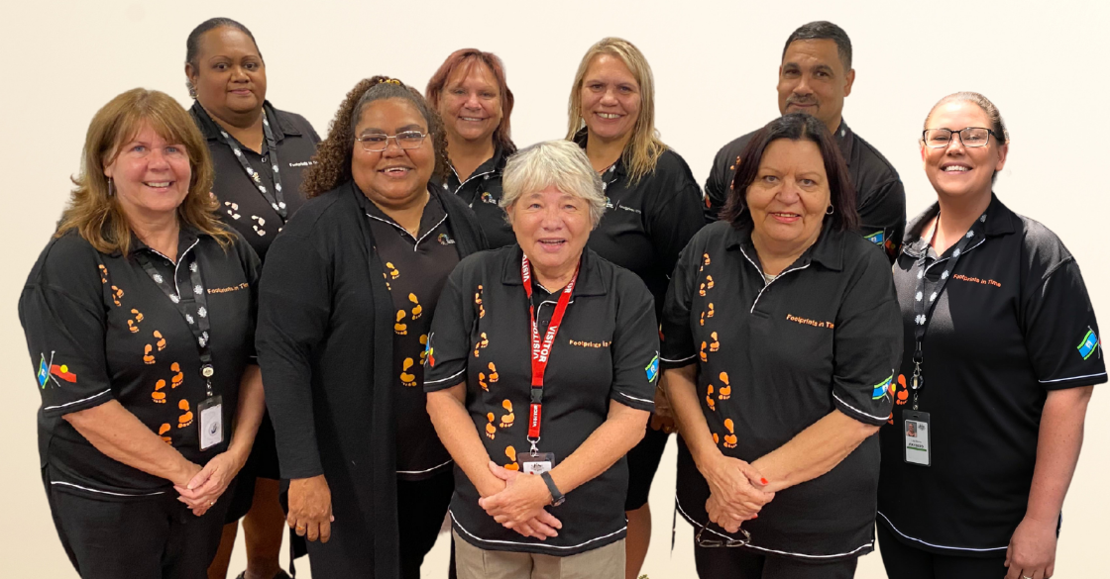
LSIC Overview
What: LSIC is one of the largest studies
of Indigenous children worldwide &
follows Aboriginal & Torres Strait Islander
children and their carers over time.
Who:
DSS employs full time Aboriginal and
Torres Strait Islander people to conduct annual interviews.
Nearly 1,700 families from remote, regional and urban Australia were in the first LSIC survey in 2008.
There are still more than 1,500 families involved in the study
Pictured above: 2021 LSIC RAOs

Slide 6
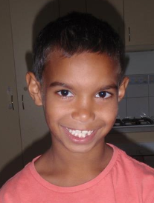
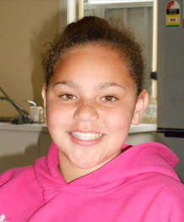

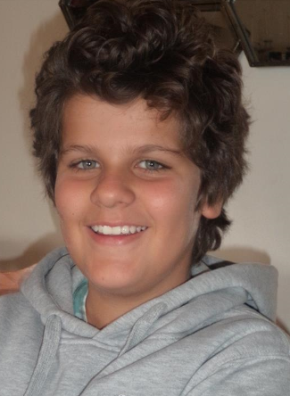
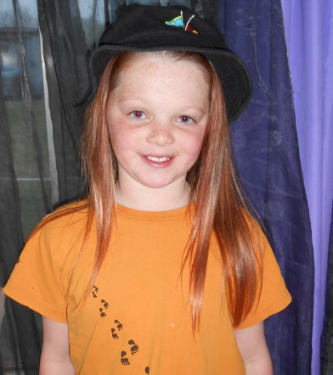
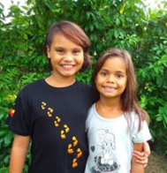
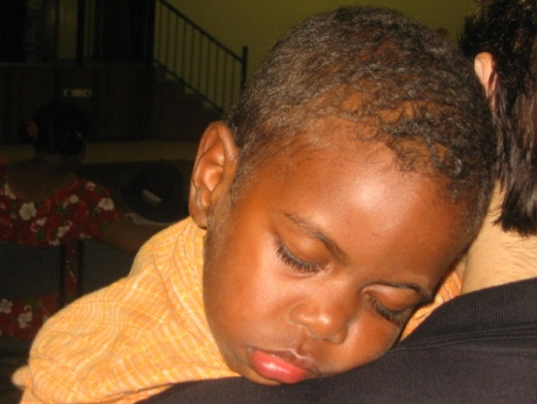
LSIC Overview
When: Consultation, trials and pilots 2004-2007.
Annual data collection from 2008.
Why: To explore how early childhood
affects later life outcomes for Aboriginal
and Torres Strait Islander children
and find out what helps children
to grow up strong.
What: The study collects information about
family relationships, child and parent education, strengths, health, culture, community, racism, life events, identity, contact with the justice system, employment, financial hardship, aspirations…
Note: The pictures in this presentation are of LSIC kids and are shown with parent or carer permission

Slide 7
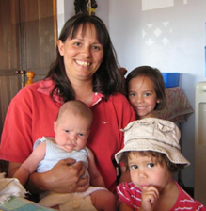
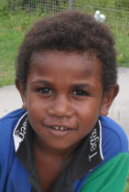
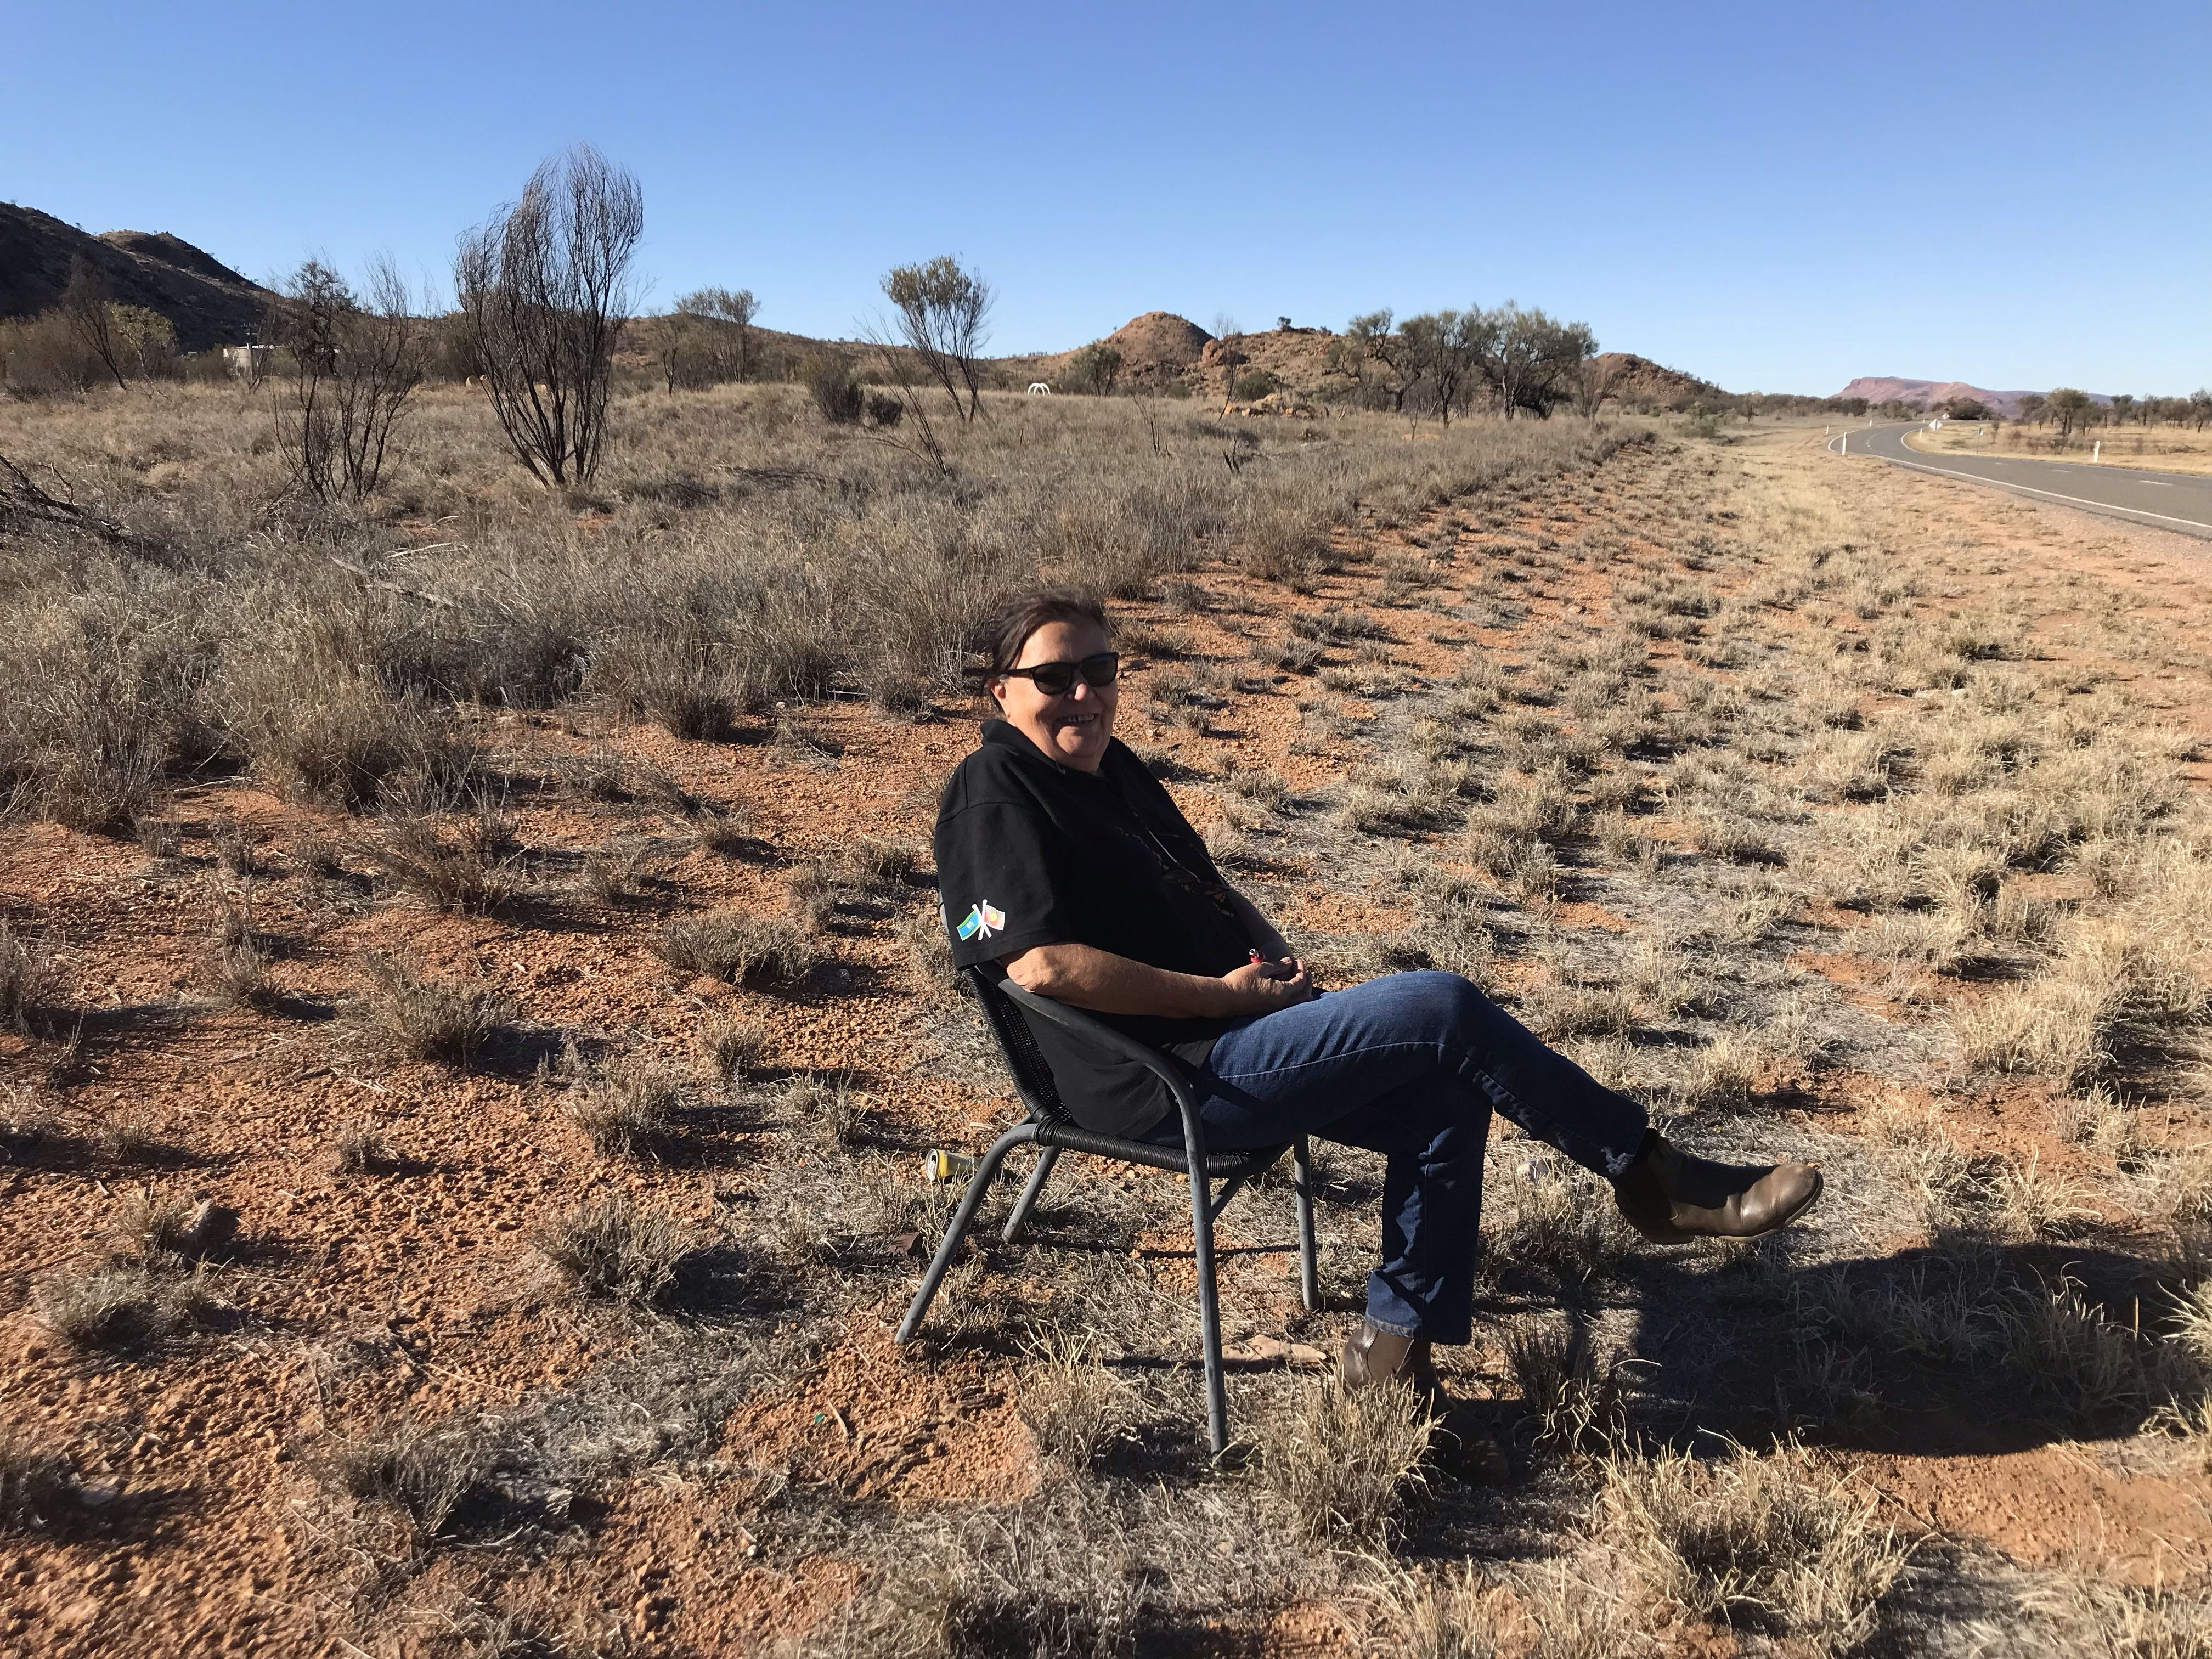
LSIC Overview
Two groups: in 2008 B cohort were 0-1 years old
K cohort were 3-4 years old
11 waves of confidentialised data are available via the Australian Data Archive at ANU, including:
  NAPLAN, MySchool and Australian Early Development Census linked data
Wave 12 data will be released later this year (with all previous waves)
Nearly 200 researchers in universities and government are using LSIC data in fields such as epidemiology, economics, education and social research

Slide 8
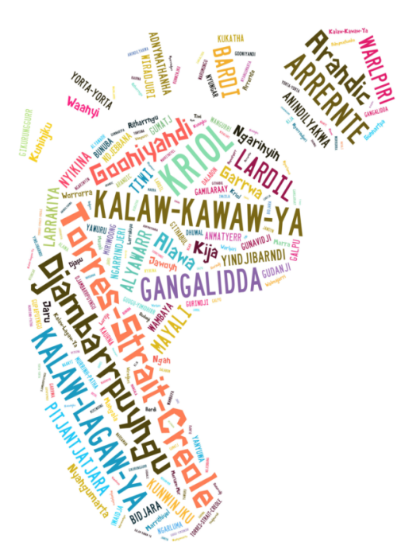
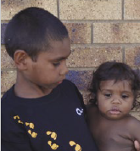

Sample characteristics
2008, 2009
Parent 1:
75% Aboriginal
4% Aboriginal & Torres Strait Islander
7% Torres Strait Islander
15% not Indigenous
27% of parent/carers speak an Indigenous
language
LSIC children
LSIC Children belong to more than 80 tribal / language groups or clans
Over 300 children speak more than one language – many 2 or more

Slide 9
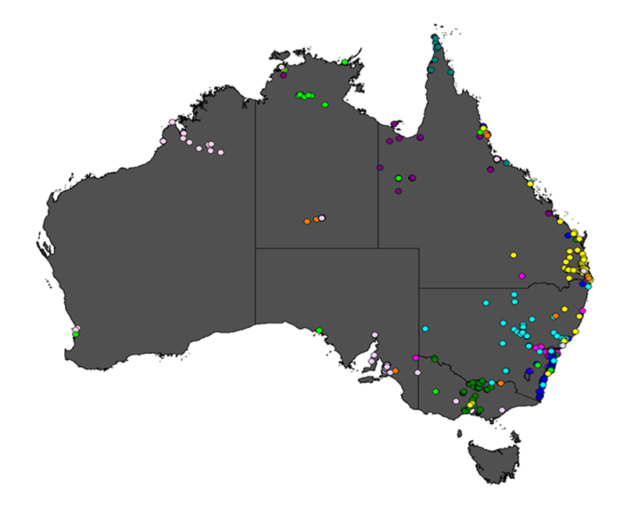
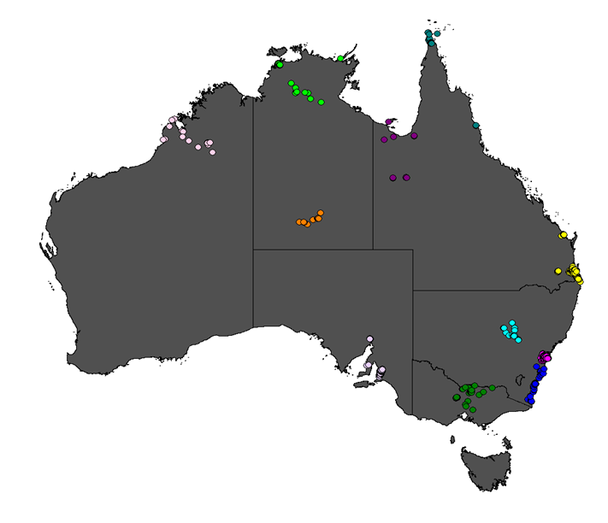
Where do LSIC families live?
LSIC respondents
in Wave 10
LSIC respondents
in wave 1

Slide 10
Retention
Number of completed interviews/surveys, waves 1–12
Note: No Parent 2 (P2) / Dads surveys were administered in Waves 3 or 6.

Slide 11
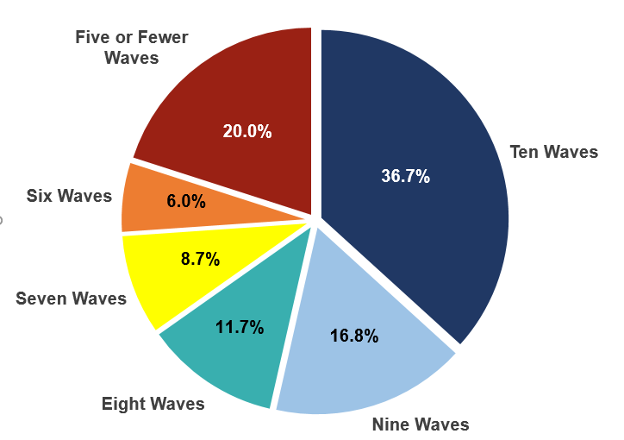
Re-interview rates
Proportion of families by number of waves interviewed – per cent

Slide 12
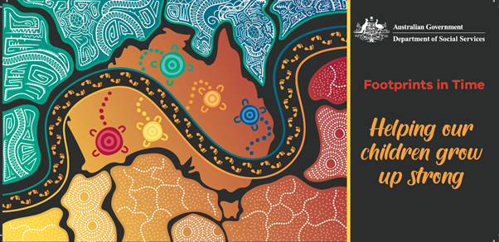
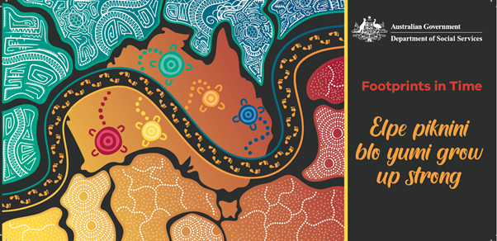
Giving back
LSIC is committed to providing feedback to families and communities via:
newsletters (biannually from 2021) with data summaries
calendars with pictures of the Study Youth, and
in new ways such as through local language.
The 2021 LSIC contact card has been produced in Torres Strait Creole with translation by Annie Wacando, one of the LSIC interviewers.

Slide 13
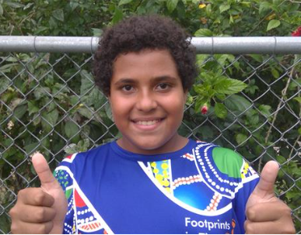


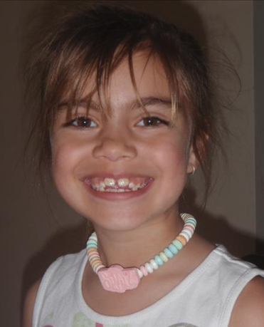

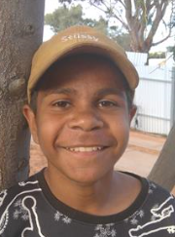


Growing up Strong

Slide 14
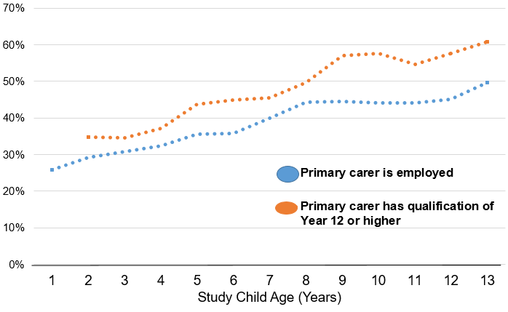
Highlights from the report
Employment and education of primary carers, by study child age—per cent

Slide 15
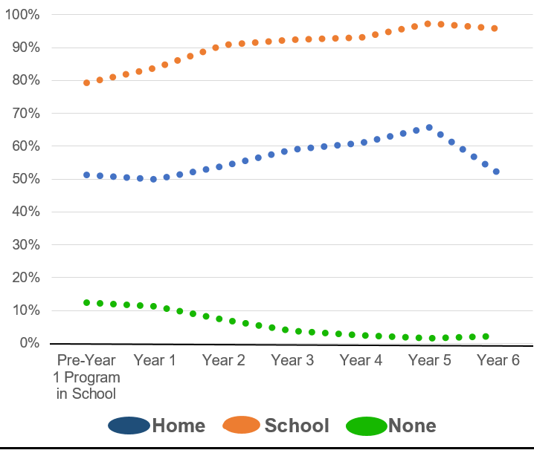
Highlights: computers, internet, mobile phones
Computer use of children in
Footprints in Time by school year level, Waves 6 and 8 (2013, 2015) - per cent
In Wave 8 (2015):
15.6 per cent of study children had their own mobile phone
72.0 per cent of P1s reported that their household had internet access (97% Australian households with children under the age of 15 in 2016–2017 (ABS, 2018))
95.6 per cent of study children had access to a computer (at home, school or elsewhere),
only 55.0 per cent were using a computer at home
N=1,414 children across two time points – 2,431 observations

Slide 16
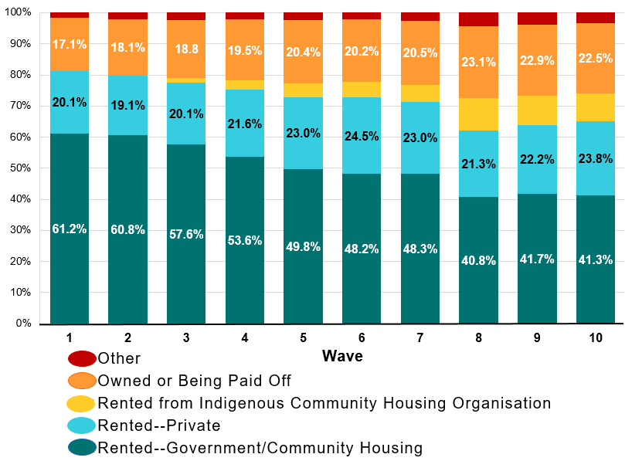
Highlights: housing changes
Source of housing for primary carers, Waves 1 - 10 (2008–2017) - per cent
In Wave 1 (2008), 61.2% of parents and carers were renting from a government organisation
by Wave 10, this figure had decreased to 41.3 per cent
Data on renting from Indigenous Community Housing Organisations (ICHO) was not separately collected until Wave 3 (2010).
Since Wave 3 the proportion of LSIC families renting from ICHOs has increased from 1.3% to 9.1% in Wave 10 (2017).

Slide 17
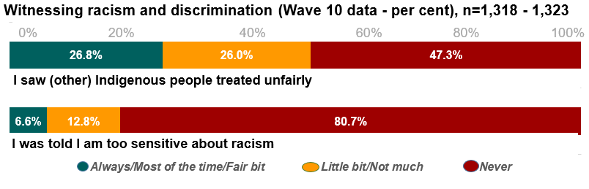
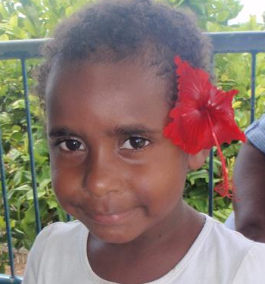
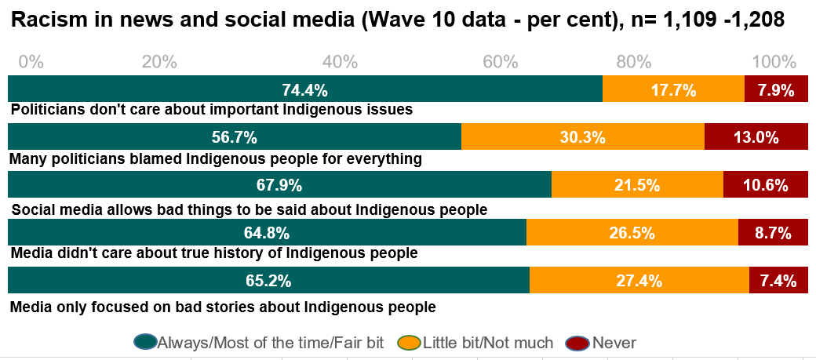
New racism questions in Wave 10 (2017)

Slide 18
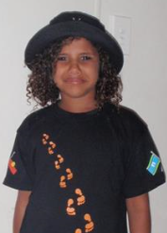
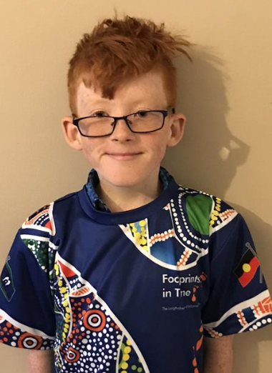
Bilingual children tend to have fewer social and emotional difficulties (Parent reported Strengths and Difficulties Questionnaire, 2015)
In 2015, 20.9 per cent Footprints in Time households reported speaking 2 or more languages in the home.
Children who spoke an Indigenous language as their main language,
or spoke English and an Indigenous language equally well, tended to have fewer social and emotional difficulties.
N=1174 (P<0.05)

Slide 19

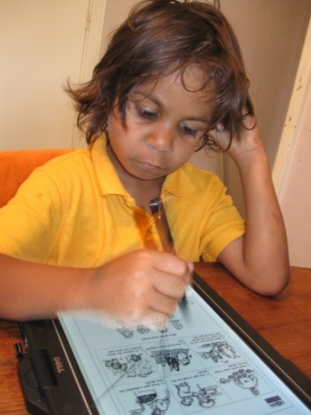
Literacy and numeracy at school
In wave 6 (2013) the B cohort were in Pre Year 1 &
Year 1, the K cohort in Years 3 & 4. More than
500 teachers completed surveys about LSIC kids.
Teachers were given statements about their school’s Aboriginal and Torres Strait Islander education focus, including:
This school is using the Australian Curriculum cross-curriculum priority of Aboriginal and Torres Strait Islander histories and cultures in its teaching.
 | n | %
Currently doing | 234 | 45.5
Working on | 149 | 29.0
Not doing | 46 | 8.9
Don't know | 85 | 16.5
Total | 514 | 100.0

Slide 20
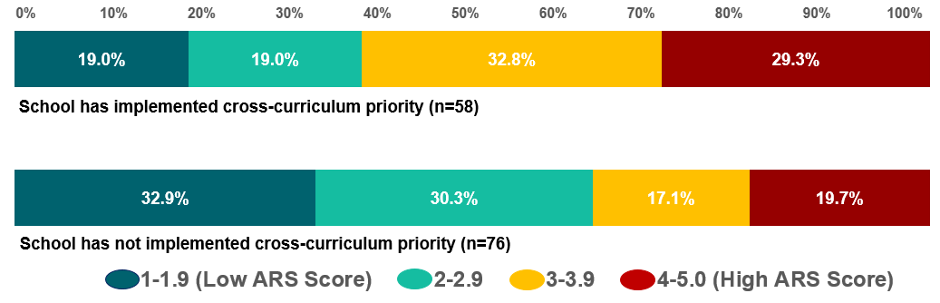
Foundational literacy
Study children’s Year 1 literacy scores by whether the school had implemented the cross-curriculum priority of Aboriginal and Torres Strait Islander histories and cultures
Wave 6 (2013)
Note: Higher scores mean greater English language and literacy skills as rated by teachers

Slide 21
What relates to LSIC
children's literacy scores
Factors associated with children’s literacy scores on
the Academic Rating Scale (ARS), Wave 6 (2013)
Adjusted R² = 0.24, n=462
Note: Orange bars indicate statistical significance at p < 0.05. Grey bars indicate the characteristic is not statistically significant. The model includes children in school years ranging from pre-Year 1 to Year 4.

Slide 22
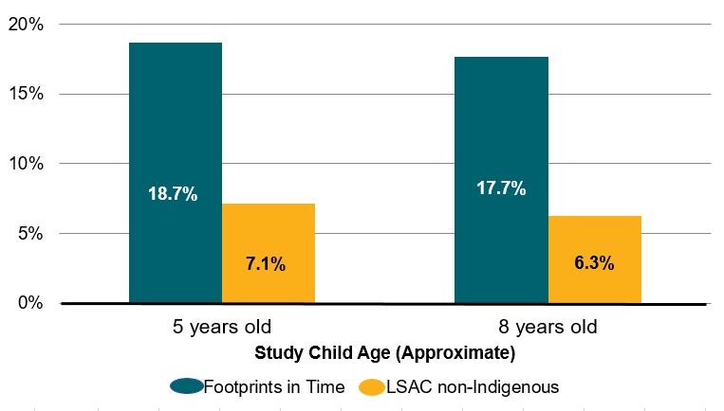
Sleep
Sleep disturbance among LSIC children (Wave 5, 2012) and
LSAC non-Indigenous children (Release 6, Waves 1-6, 2014) - per cent
Note: numbers of observations: n = 679 for LSIC children & n=10,505 for Longitudinal Study of Australian Children (LSAC) children

Slide 23
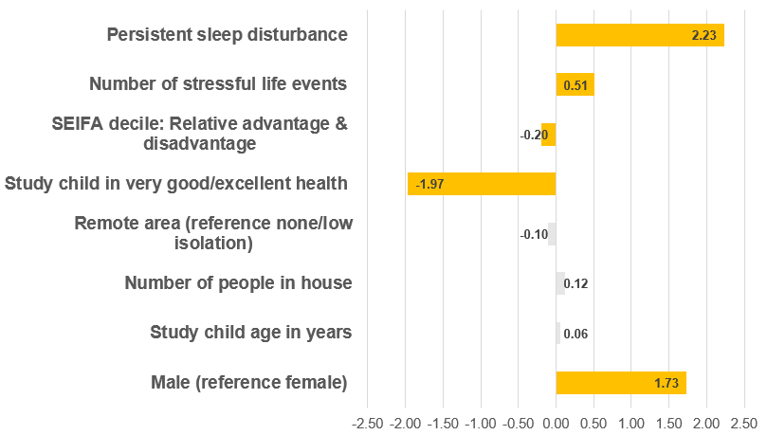
Social & emotional difficulties and sleep
Relationship between social and emotional difficulties & persistent sleep disturbance, LSIC child’s health & family experience of stressful life events, Waves 1–6 (2008–2013)
Good
NB: Yellow bars show statistical significance at p<0.05.
Grey bars indicate no statistical significance.
The model includes persistent sleep disturbance (sleep problems in 3 or more waves from Waves 1–5). All other variables from Wave 6. Total n=970.
Adjusted R² = 0.09, n=970

Slide 24
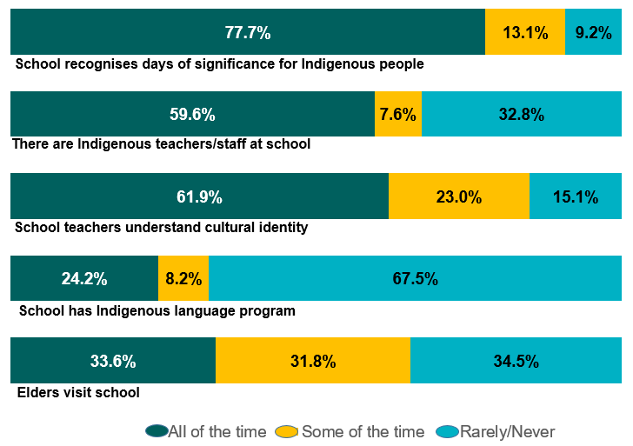
Cultural awareness at school
Parent-reported cultural awareness in schools, Wave 7 (2014) - per cent
N= between 982 and 1,139 depending on the question.

Slide 25
Free text
LSIC collects verbatim answers that can be used by analysts in a variety of ways.
For both non-Indigenous and Indigenous researchers using the ‘free text’ offers the opportunity to “Privilege the voices, experiences and lives” of the Aboriginal and Torres Strait Islander participants.*
For example here are some of the parents and carers Wave 6 (2013) responses to the question: Why do you stay in the study?
  “Great record of how Indigenous kids live, learn and grow.”
  “I like that [study child’s name] will have something to look back on
  and say to her children, ‘My mum did this’.”
  “Cause I think I want the general public to know that there
  is good statistics on Indigenous children.”
  “Good information for government.”
*Rigney in Martin (2003)

Slide 26
Data to look forward to
Wave 11 available now | Wave 12 later this year | Wave 13 in 2022
Cultural identity and the importance of various aspects | Languages spoken at home NB Learning Indigenous languages at school has asked since Wave 6 | COVID-19 and effect on study youth, families, and communities
Bush tucker - types Study Youth eats; English reading comprehension | Paid and unpaid work, hours; if working in school term; safety at work; reasons for stopping work | Understanding of issues including Land Rights, Native Title and Treaty
Sleep: amount; if sleep is troubled and why; is Study Youth getting enough sleep | Whether teachers have had anti-racism education & training in strengths-based approaches | Qualities such as being: reliable, a good storyteller, good at caring for country, persistent, kind, creative
Caring responsibilities of parents and youth | Cyber safety activities e.g. deleting posts, reporting, blocking, stop using | Friends and peers qualities, risk behaviours and academic engagement

Slide 27
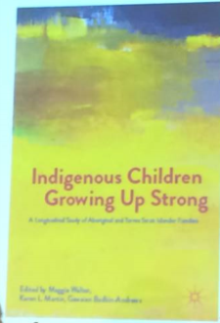

Impact
Indigenous Children Growing Up Strong: A Longitudinal Study of
Aboriginal and Torres Strait Islander Families (2017)
Editors: Maggie Walter, Karen L. Martin,
Gawaian Bodkin-Andrews.
Policy changes
LSIC data helped inform the extension of Family Tax Benefit to ABSTUDY recipients aged 16 to 19 - helping families with children living away from home for study
LSIC in key policy reports:
Overcoming Indigenous Disadvantage Report:
Key Indicators 2020 (LSIC mentioned 22 times)
Knowledge Exchange Platform
AIATSIS Indigenous Research Exchange – we hope LSIC will feature in the research available via the platform
More than 17,000 downloads

Slide 28


How does LSIC inform CTG targets
The new National Agreement on Closing the Gap (CTG) came into effect on
27 July 2020; signed by the Coalition of Peaks together with Australian governments
  LSIC collects information that can inform most of the 16 national socio-economic targets - education, employment, health and well-being, justice, safety, housing, land and waters, and Aboriginal and Torres Strait Islander languages
LSIC can answer questions such as:
What influences strong family relationships?
Does post natal depression affect later child outcomes?
Does learning a language at school help with school engagement?
NB LSIC is not a population survey and cannot be used to measure population change in relation to the targets

Slide 29
Find out more about LSIC
An electronic copy of the Decade of Data report and more information about the survey is available here: www.dss.gov.au/lsic
Fill in the order form at the front, or from the Footprints stall to order electronic or hard copies of the report
Data Access: you can apply for the data via the Australian Data Archive: https://dataverse.ada.edu.au/dataverse/lsic
  Data user workshops can be arranged to assist users of LSIC data to understand and navigate the LSIC datasets. Please email: lsicdata@dss.gov.au
  Ad hoc data requests are available for small requirements. Please email
  your request to lsicdata@dss.gov.au
  Bibliographic research repository for analysis:
  see http://flosse.dss.gov.au/

Slide 30


Slide 31
